Slide 1



Characterization and implementation of an information system at the “Administration of Jewish Identity”
Milestone 3
Submitted by: ELCHAI REFOUA NADAV KADOSH BARAK ZEBERGER
Academic advisor: Dr. Asaf botser
Industry advisor:
YAEL AMUSY

Slide 2



Slide 3
A reminder of the organization

Slide 4
Background on the organization
“The Administration of Jewish Identity”, which is also called “the Jewish Identity Division”, a unit attached to the Ministry of Religions (formerly known as the Ministry of Religions), following the formation of the government in 2013.
The main goals of the unit are - "Increasing the respect, love, and identification between sections of the population through a combination of the basic components of the historical identity and national heritage of the Jewish people."
The unit operates engagements through a variety of different bodies, these bodies deal with exposure to Jewish and Israeli identities.

Slide 5
The problem

Slide 6
The problem
Most bodies today have different systems in which day-to-day operations are conducted.
The communication between the coordinators and the project managers to the principal is conducted inefficiently, the information reaches the principal from each body in a different way (internal systems, "EXCEL", "Whatsapp" etc.) and of course without a uniform format for everyone.
Due to the above shortcomings, the principal finds it difficult to delay the various activities, and as a result, the budget distribution is deficient.
Lack of cooperation with the people on the ground, especially with the coordinators.
Notes:
לרוב הגופים כיום יש מערכות שונות שבהן מתנהלת התפעול השוטף.
התקשורת בין הרכזים ומנהלי הפרויקט למנהל מתנהלת בצורה לא יעילה, המידע מגיע למנהל מכל גוף בצורה שונה (מערכות פנימיות, " EXCEL", "ווטסאפ" וכו') וכמובן ללא פורמט אחיד עבור כל אחד.
בשל הליקויים הנ"ל מתקשה המנהלת לעכב את הפעילויות השונות, ובשל כך חלוקת התקציב לוקה בחסר.
חוסר שיתוף פעולה עם האנשים בשטח, במיוחד עם הרכזים.

Slide 7
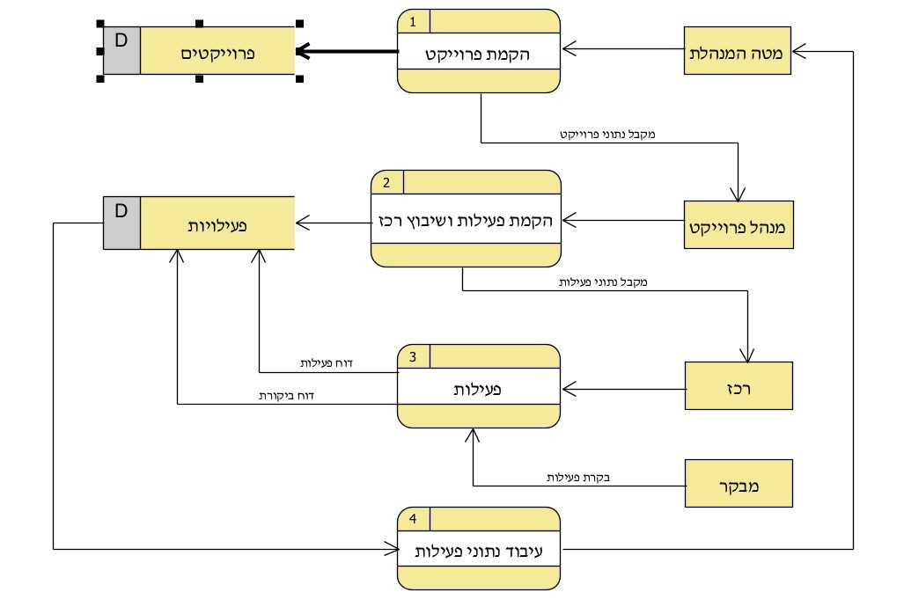
Chart
TO BE
solution
Vocabulary:
Project - פרויקט
Activity פעילות -
Activity data processing –
עיבוד נתוני פעילות
Administration - מטה מנהלת
Coordinators - רכזים
Project manager - מנהל פרויקט
Inspector בקר -
Reporting activity - דיווח
DFD 1
DFD 1
Notes:
אלחי

Slide 8
Scenarios and data for testing

Slide 9
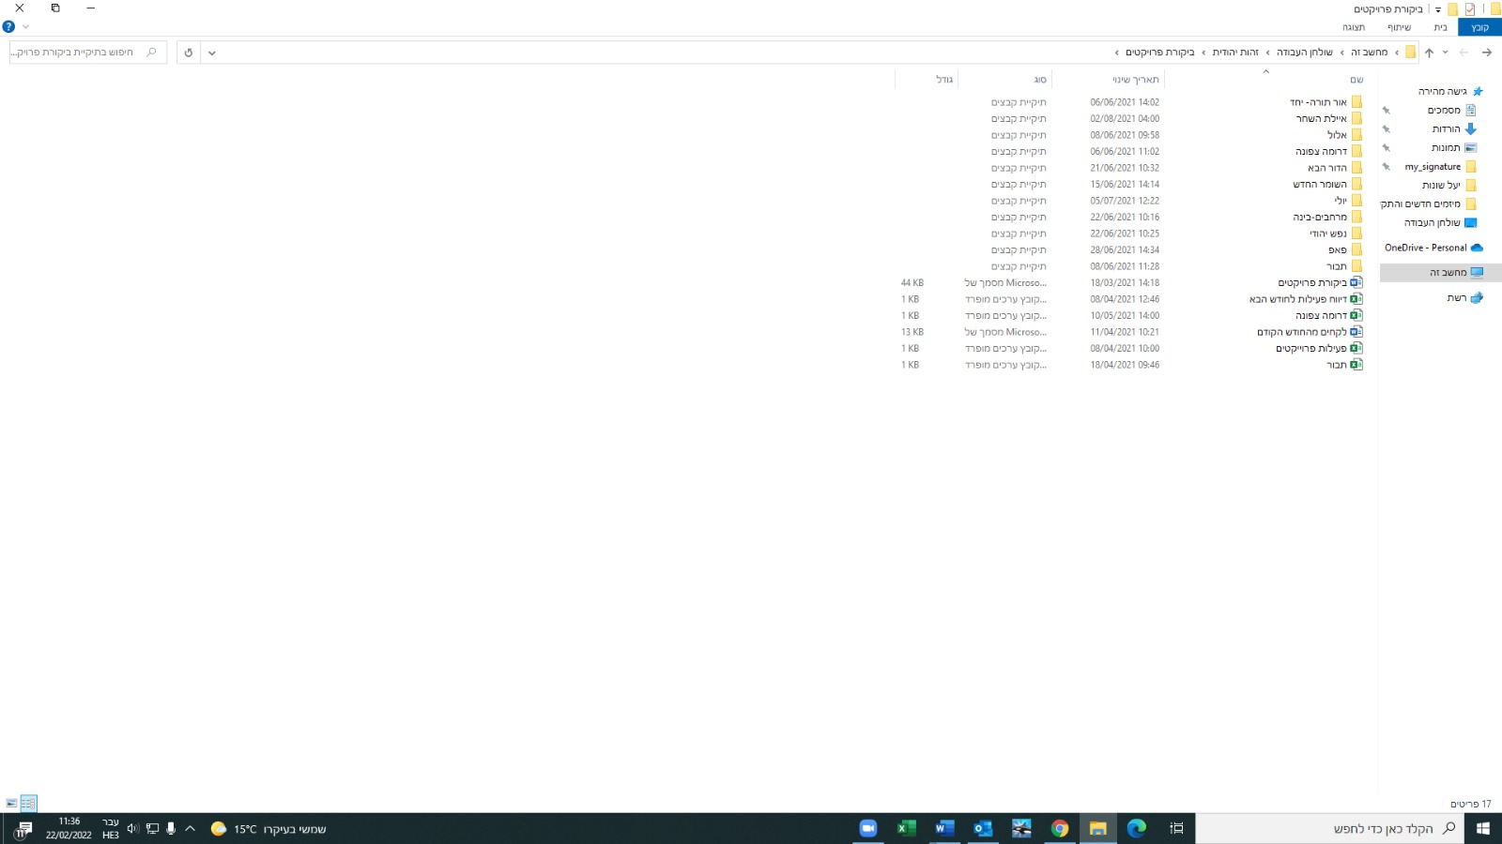
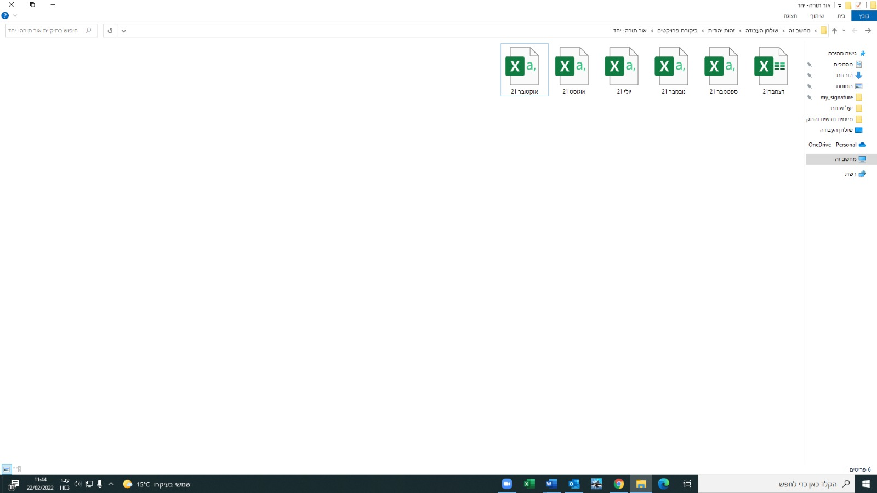
Data for testing
Administration
solution

Slide 10
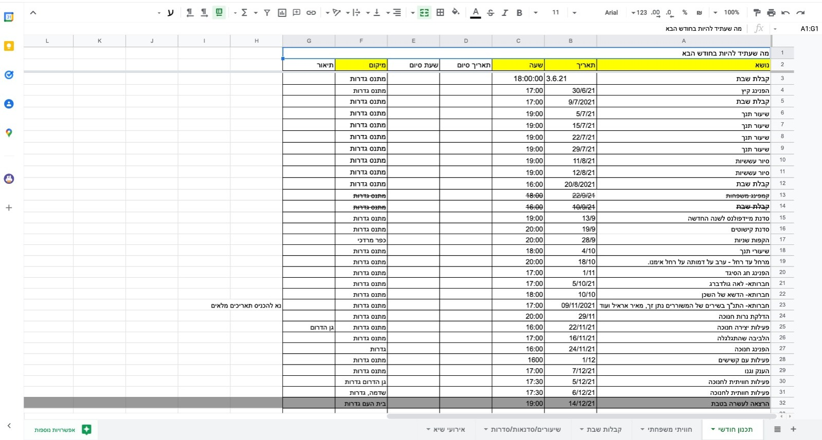
Data for testing
Coordinators

Slide 11
Scenarios:
Description of the implementation, experimentation and test runs

Slide 12

Scenarios
massage | Action | Input | Modules
massage from the system – “Your registration is done” If details are wrong there will be a massage about it. | Clicking on “login” | Users' information: Username and password | Sign-up to the system
Hello project manager, and creating a new activity | Clicking on “project managers” | - | Enter the desired page - project managers
4 rubrics to fill in details about the activity and another button to save | Clicking on “new activity” | - | creating a new activity
All rubrics will disappear, and the user will have to select the button that pulls it out - | Click on "Save" | Project data: Select the project name, activity type, location And the name of the coordinator | Adding a new activity
Notes:
ברק

Slide 13
Result | Action | Input | Modules
Hello project “coordinators” and Fill out my activity report/ activities | Clicking on “coordinators” | - | Enter the desired page - coordinators
Marked by V, massage from the system – “Report saved” | Click on "Save" | Activity data: Enter data of - the topic of the activity, number of participants and date and Activation description. Selection (from a list) - start and end time, and location. | Enter the activity data
If the user made a mistake
Error message next to the rubric where the error was | - | Wrong user information (Username or password) | Sign-up errors
Notes:
ברק

Slide 14
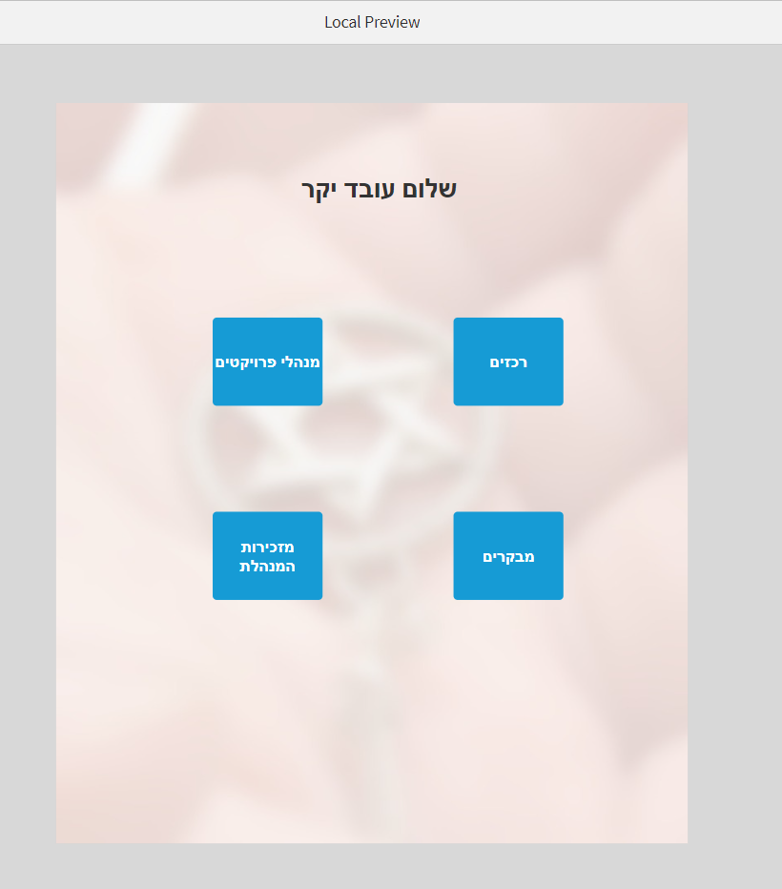
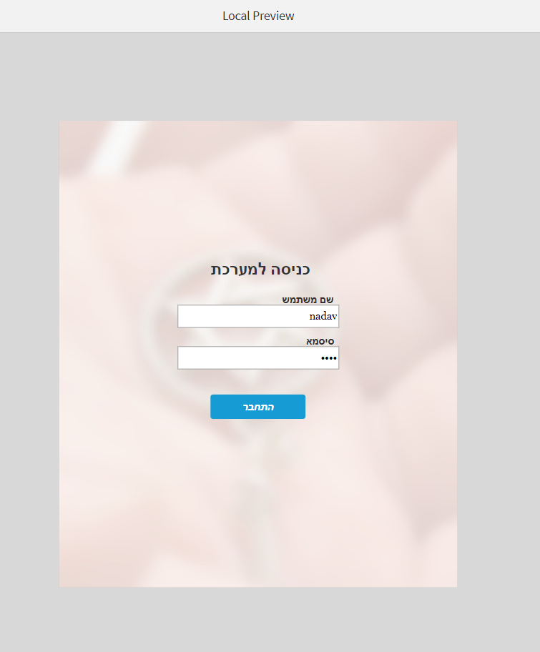
Demonstration and presentation of full implementation of the solution: Prototype

Slide 15
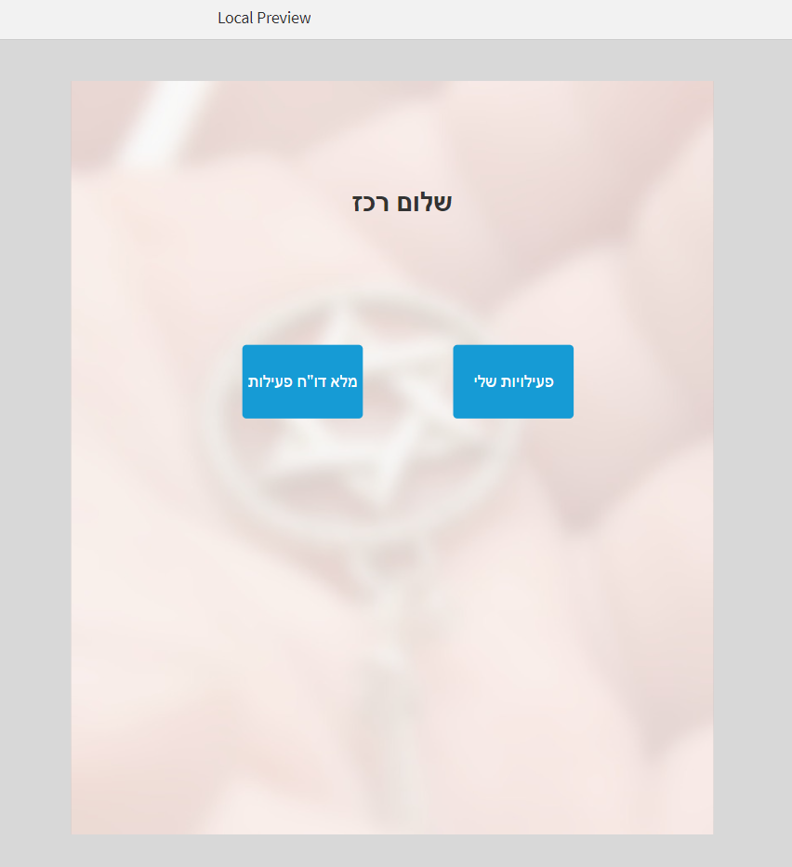
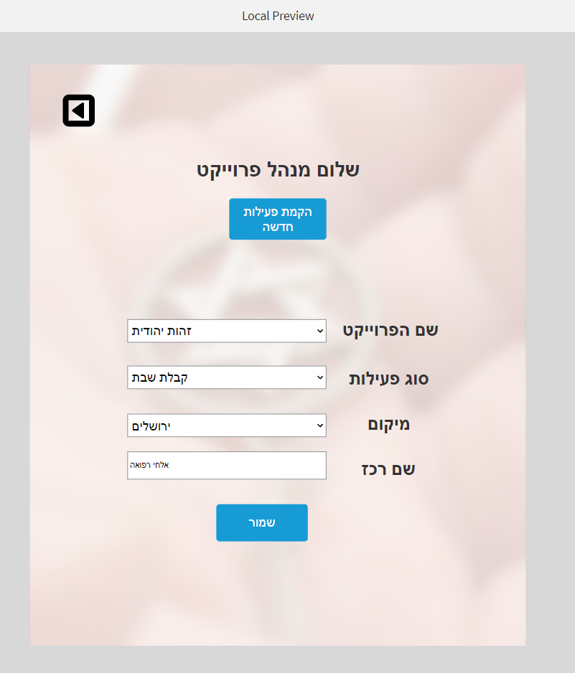
Demonstration and presentation of full implementation of the solution

Slide 16
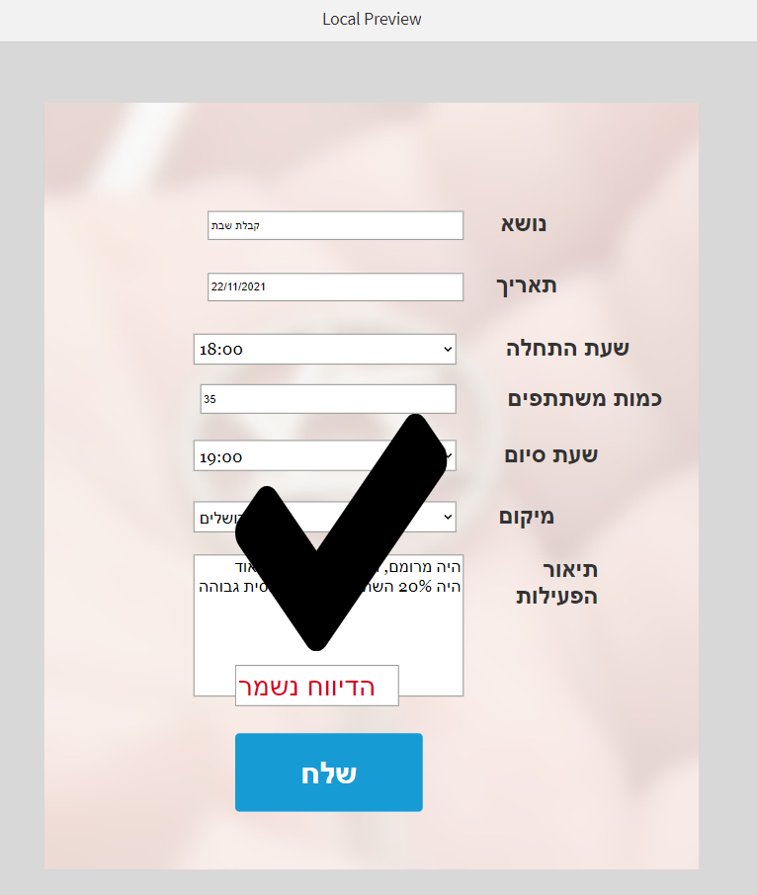
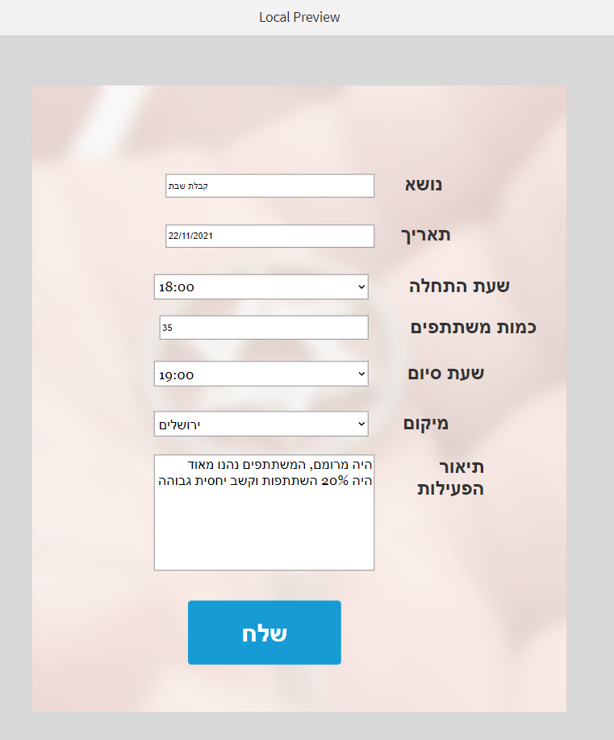
Demonstration and presentation of full implementation of the solution

Slide 17
סרטון

Slide 18
Conclusions regarding the solution proposed and to the degree of which it contributes to the situation “to be as is”

Slide 19
Due to the fact and the situation that today there is no system at all, the fact that there will be a system is a significant improvement for the administration.
The main difficulty of the administration is with the coordinators "in the field“.
Therefore, the simplicity of the system, with an addition of a good implementation capability will enable the success of the project and improve the desire of the coordinators to use the system.
The disadvantage of the stage we are at is:
the characterization we have built is very initial and partial
it is suitable only for coordinators, and therefore it is necessary to expand the system for more functionaries and deepen the scope of operations that the system has.
Notes:
בשל העובדה והמצב שהיום אין מערכת כלל, אז העובדה שיש מערכת היא שיפור משמעותי עבור המינהל.
הקושי העיקרי של המינהל הוא עם הרכזים "בשטח", ולכן, פשטות המערכת
בנוסף ליכולת הטמעה טובה תאפשר להצלחת הפרויקט ושיפור הרצון של הרכזים לשימוש במערכת.
החיסרון של השלב שבו אנו נמצאים, שאפיון שבנינו הוא מאד ראשוני וחלקי, הוא מתאים לרכזים בלבד, ולכן נדרש להרחיבו ליותר בעלי תפקידים ולהעמיק את היקף הפעולות שיש בו.

Slide 20
Adjustments, improvements and changes required for reaching the optimal solution

Slide 21
The main difficulty we face in the project is:
the Unwillingness of the coordinators to use a new system.
Due to that, we will make a number of changes towards the next step at Milestone 4 that will help us reach an optimal solution:
We will carry out a slow and thorough implementation process in collaboration with the coordinators in an agile working method.
We will look to test the system with coordinators at older ages.
We will expand the characterization of the system for more functionaries.
We will work closely with professional people in parallel with the coordinators.
We will perform satisfaction tests before and after each step, knowing how to measure progress.
Notes:
הקושי העיקרי שעומד בפנינו בפרויקט הוא חוסר הרצון של הרכזים להשתמש במערכת חדשה.
לשם כך, נבצע מספר שינוים לקראת השלב הבא שיעזרו לנו להגיע לפתרון אופטמלי:
נבצע תהליך יישום איטי ויסודי בשיתוף הרכזים בשיטת עבודה אג'ילית.
נחפש לבדוק את המערכת מול רכזים בגילאים מבוגרים.
נרחיב את אפיון על המערכת ליותר בעלי תפקידים.
עבודה צמודה יותר עם אנשי המקצוע במקביל לרכזים.
ביצוע בדיקות שביעות רצון לפני ואחרי כל שלב, לדעת למדוד את ההתקדמות.

Slide 22
Thanks for listening

